Slide 1
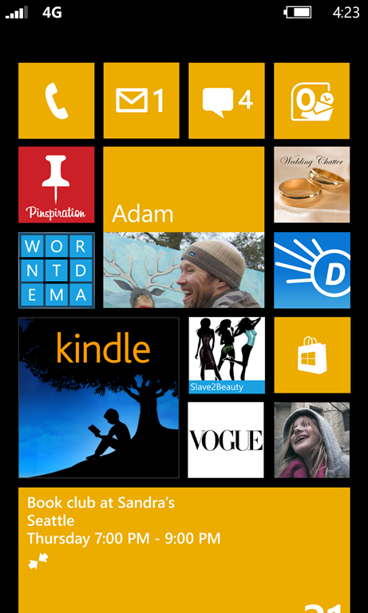
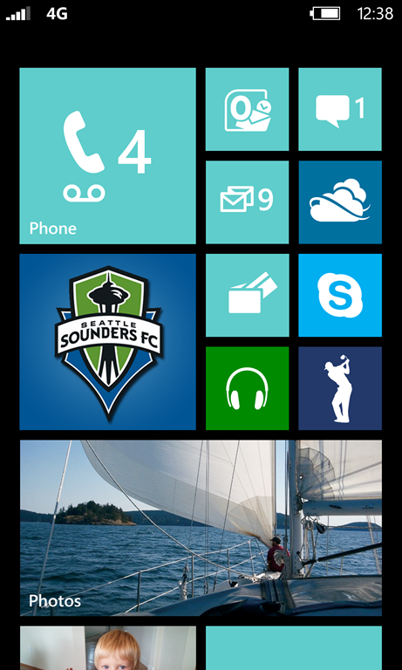
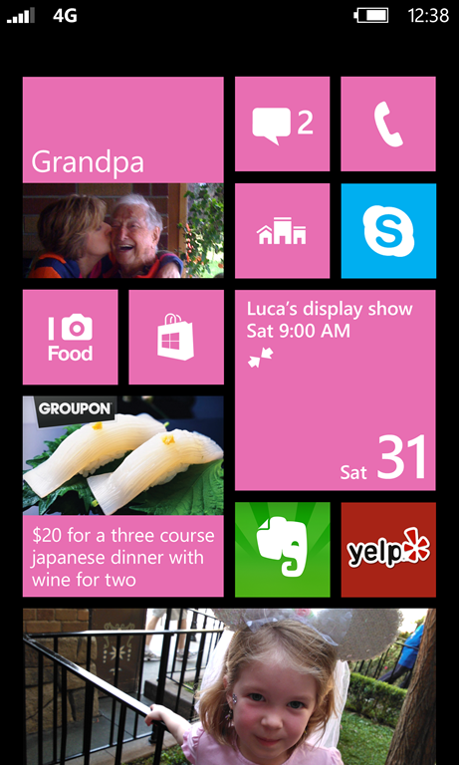
Windows phone
Greg Stoll
Nokia Developer Ambassador
austin.devnokia.com
ext-greg.stoll@nokia.com
Notes:
<Introduction> Today I’m going to be talking about three things: first some of the unique features that Windows Phone offers to users and developers, then an overview of what developing for Windows Phone is like, and finally a quick look at two new developer programs Nokia recently launched to help you be successful.

Slide 2
Swag!
To be eligible to win a Lumia 800 or Wenger backpack tonight, you must sign in with your name and email address.

Slide 3
Win a lumia 925!
Write an app, get it published in the store by November 17, and contact me to be entered.
Only open to students here tonight!

Slide 4
Platform features
Notes:
Let’s talk about some of the features that really make Windows Phone unique.

Slide 5
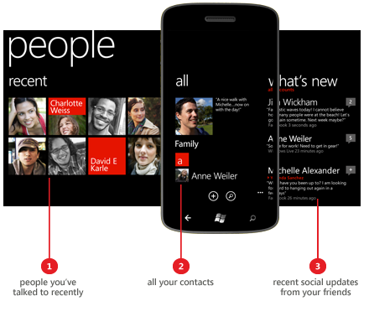
Windows phone 7 key features
Live tiles
People hub
Modern UI
Games/Xbox
Office
Notes:
Live tiles are probably my favorite feature of Windows Phone – they let you really customize your start screen experience. You can pin apps, but also people (which lets you see their recent status updates as well as have quick access for calling/texting/emailing them), and you can also pin things from within apps. For example, for a flight tracking app you could pin individual flights to the start screen and have them update when the flight status changes.
The people hub aggregates Twitter/Facebook/LinkedIn and puts them all in one timeline. It doubles as a contact list – just tap on a person and you can see their phone number and email address/twitter account/etc.
The “modern UI” is something that feels very different from iOS or Android – typography is front and center, and the general philosophy is content over chrome. (you can see this in the people hub screenshot)
You can write games for Windows Phone with XNA, which is the same SDK you can use to write Xbox games, and games can tie in to the same achievement system.
Finally, you can view and edit Word, Excel, and PowerPoint documents on your phone, and it automatically syncs with Skydrive.

Slide 6
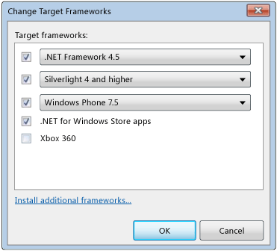
Windows phone 8 portability
All Windows Phone 7.5 apps work on WP8
Share code between Windows 8 and Windows Phone 7.5/8 with Portable Class Libraries – includes features of .NET Framework 4.5! (async/await, etc.)
Notes:
Now, on to Windows Phone 8. Not only are Windows Phone 7.5 apps compatible with Windows Phone 8, but you can use Portable Class Libraries to share code between Windows Phone, Windows 8, Silverlight, and .NET apps! This can be a great way to get started developing for Windows Phone if you have any sort of existing .NET apps.

Slide 7
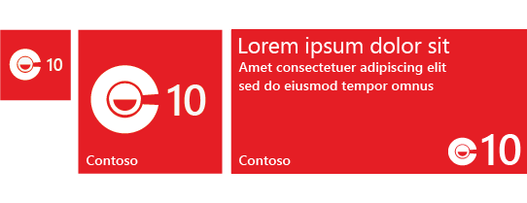
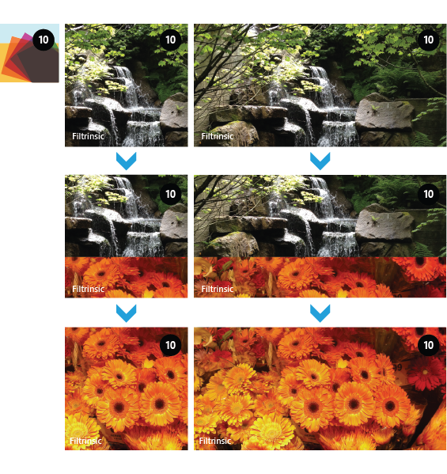
Windows phone 8 live tiles
Three sizes of live tiles
New styles: Iconic and Cycle
Notes:
One of the flashier new features in Windows Phone 8 are the new sizes of live tiles. In Windows Phone 7 third-party apps could only use “medium” live tiles, but now small, medium, and large tiles are available to all apps. The user decides what size to make each tile, as well as its position on the Start Screen. Apps should support all three sizes of live tiles. There are also a few new styles – iconic for apps that want to emphasize a count (e.g. new messages) and cycle for apps that want to rotate through full-size pictures.

Slide 8
Windows phone 8 new apis
Lock screen background/notifications
Speech APIs for in-app voice commands
Wallet APIs for coupons, credit cards, memberships, etc.
Native (C++) apps with Direct3D
Lens extensibility for custom camera viewfinder, etc.
Advanced camera APIs (exposure time, etc.)
VoIP, Bluetooth, NFC
…
Notes:
Windows Phone 8 also has a bunch of new APIs for developers to take advantage of.

Slide 9
Developing for windows phone
Notes:
Now let’s talk about some of the nuts and bolts of developing for Windows Phone.

Slide 10
Dreamspark
As UT students, you have free access to a ton of Microsoft products (including tokens to get in the Windows Phone Store) through Microsoft DreamSpark!
See http://www.utexas.edu/its/products/dreamspark/index.php or https://www.dreamspark.com/ for more DreamSpark info
More info on Windows Phone Store account: http://blogs.msdn.com/b/cdnstudents/archive/2012/09/24/how-to-get-your-free-student-windows-phone-store-account.aspx

Slide 11
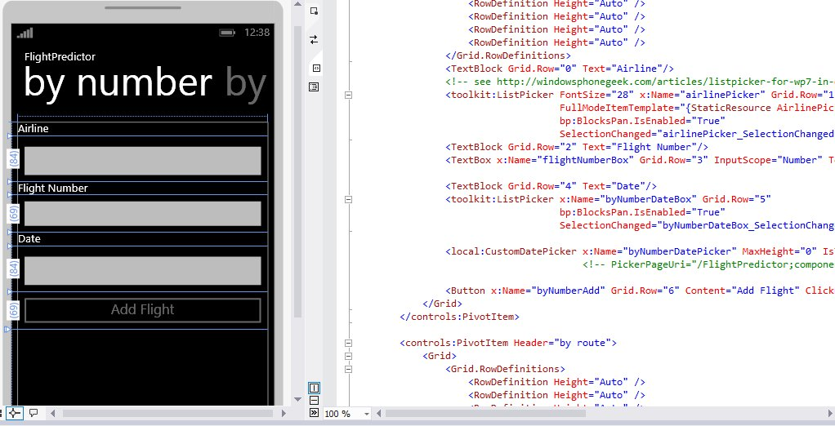
xaml
Windows Phone model revolves around pages with URIs
XAML is a declarative XML-based format used to design pages
Notes:
I’m going to focus on XAML apps here, as opposed to C++ or XNA apps. XAML apps use a page-based model, and the UI for a page is generally laid out in a XAML file. You can also use the designer in Visual Studio to drag and drop controls on a page, which will generate the XAML for you.

Slide 12
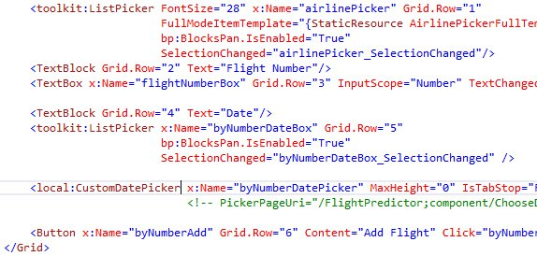
xaml
Many UI elements, such as StackPanel, Grid, Button, TextBlock, etc.
Each can have a Name, which makes the element accessible from code
Notes:
There are a bunch of UI elements, both for layout (StackPanel, Grid) and more standard UI elements (Button, TextBlock). Each XAML file has a code file behind it, and if you give a UI element a name you can access it from code.

Slide 13
Xaml and data binding
Each XAML element can have a DataContext for use with data binding
Can bind to members of the DataContext with the {Binding} syntax:
Makes it easy to separate view (XAML) from model
Notes:
Generally you set the DataContext on an entire page to be a model class, and then use data binding to access individual elements and display them on the page. Most properties on UI elements are Dependency Properties, which means they support the binding syntax. If the element you’re binding to supports INotifyPropertyChanged, the view will automatically update when the value changes!

Slide 14
Value converters
For more complex datatypes, can use value converters in XAML to define how they’re displayed. For example:
A few builtin converters, but very easy to define your own
Notes:
To avoid having view-specific code in your model, the view can change the way a model property is displayed by specifying a value converter. A value converter can convert from any type to any type – in this example it’s converting from a Boolean to a Visibility.

Slide 15
Page navigation
Each page has a URI, like “/DetailsPage.xaml?ItemID=5”
Navigate to new page with NavigationService.Navigate(uri);
Each app maintains “back stack” (for physical back button) – can also trigger with NavigationService.GoBack();
Handle transitions in OnNavigatedTo() and OnNavigatedFrom()
Notes:
The name of a page’s XAML file is its URI. Each app has its own “back stack” which is used when the user presses the physical back button. OnNavigatedTo() is called when a page becomes shown either for the first time or if the app is being returned to, and OnNavigatedFrom() is called when the page is no longer frontmost, or the app is being left.

Slide 16
App lifecycle
Notes:
There are three states that apps can be in. Running means the app is currently showing on screen. Dormant means the app is no longer showing or taking up CPU time, but its state is still in memory so it can be quickly resumed if needed. If the OS needs to free up memory, the app will move to the Tombstoned state, which means the app is essentially terminated, but remembers its state (what page it was on, etc.) so if the user switches back to it, it will launch again but then resume where the user left off.

Slide 17
Panorama control
Notes:
The panorama control is an interesting UI control that’s used in a lot of apps. The idea is that the phone screen is really just viewing a slice of a larger view – in the example above, the “virtual page” is much wider than the phone. The user sees one column at a time but there is a visual indicator that there’s more content to the left or right.

Slide 18
Live tiles
Can update with background agent
Run every 30 minutes
Limited to 25 seconds
Per-device limit – can be as low as 6
Notes:
Live tiles are a key OS feature. You can just update the tile when the app is running, but keeping the tile updated even when the app isn’t running is a better user experience. There are two ways to make them truly live – one involves having a background process that runs every 30 minutes and updates the tile. This has some serious limitations – there’s a strict limit on CPU usage, and there is a limited number of agents that can be active on a device which can be as low as 6. (On the Lumia 900 the limit is 9) The background agent will be automatically unscheduled if it crashes twice in a row or if the app hasn’t been launched in 2 weeks.

Slide 19
Live tiles
Other option is push notifications
Requires external server
Can fully customize tile through a push notification, just like a background agent
Better for battery life
Notes:
The other option is to set up push notifications. You can fully specify the tile format, including pointing at local or remote images. There’s no limit on these, and it’s better for battery life.

Slide 20
Nokia developer programs

Slide 21
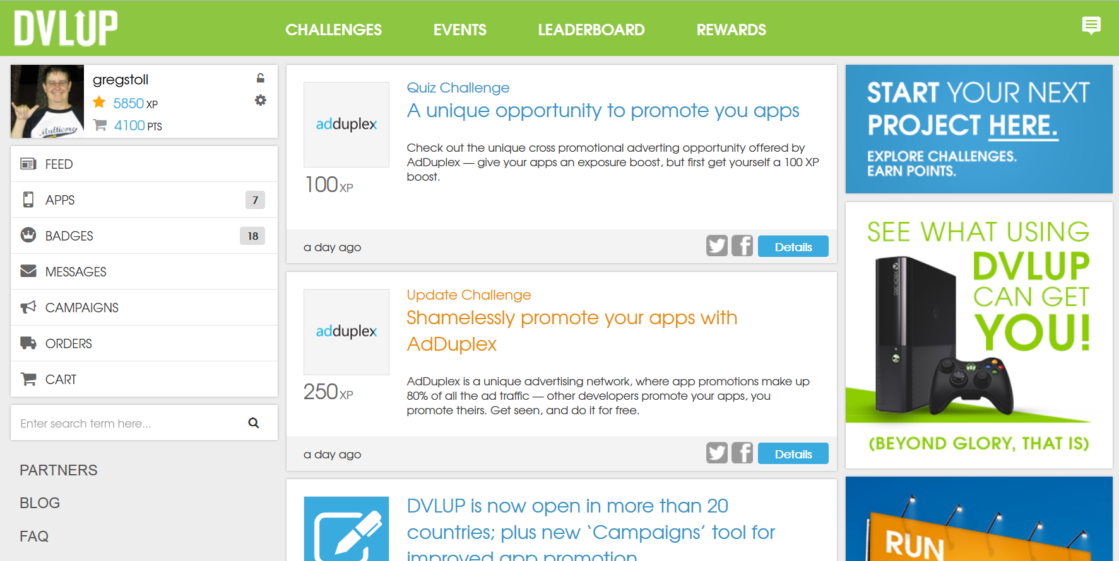
Dvlup

Slide 22
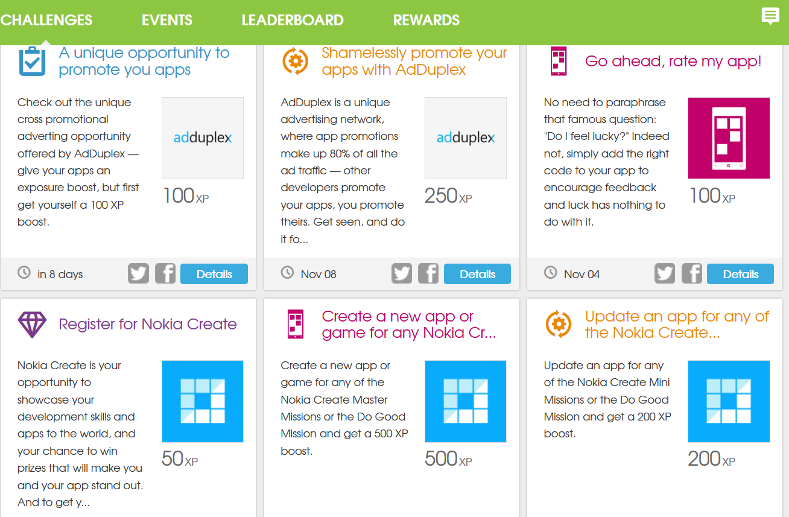
DVLUP
DVLUP is a developer reward program where you can earn points and exchange them for prizes!
DVLUP also includes a device trade-in program as well as a device loaner program.

Slide 23
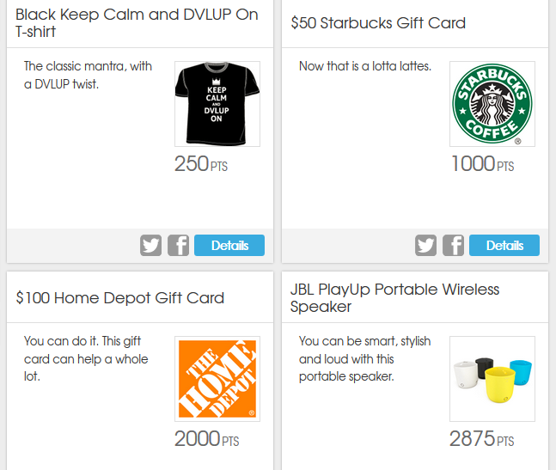
DVLUP
DVLUP prizes include gift cards, swag, Nokia phones, and even Microsoft Surface tablets!

Slide 24
DVLUP
Special challenge for students – earn 350 XP for each app (up to 5) until the end of the year!
For UT students – write an app for a local business or nonprofit for 2000 XP!
Sign up at dvlup.com!
ext-greg.stoll@nokia.com

Slide 25
Win a lumia 925!
Write an app, get it published in the store by November 17, and contact me to be entered.
Only open to students here tonight!

Slide 26
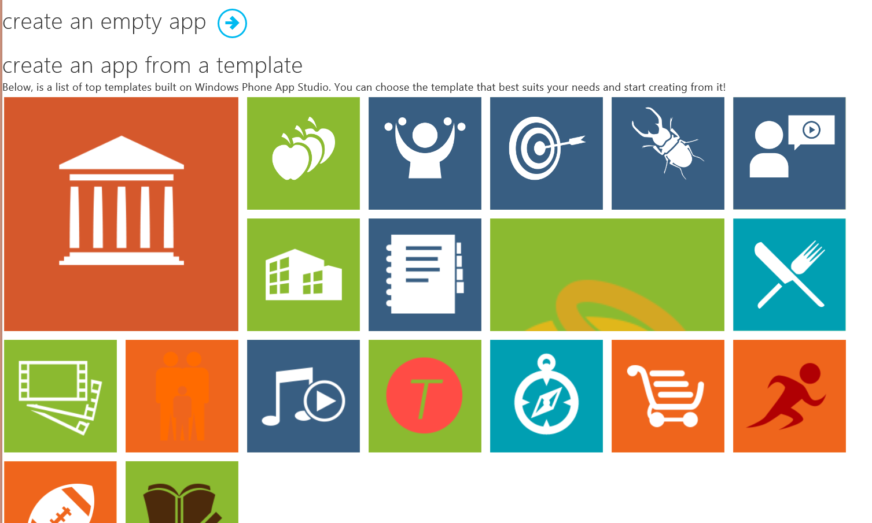
App studio
See apps.windowsstore.com for an easy way to get started with a Windows Phone app!

Slide 27
Nokia Imaging SDK
Really fast preview of any region of the image
Complete set of base filters and effects (52 filters). Combine them to generate more complex ones
Highest performance and low memory consumption through RAJPEG technology (>15 patents)
Cropping and JPEG compression parameter control

Slide 28
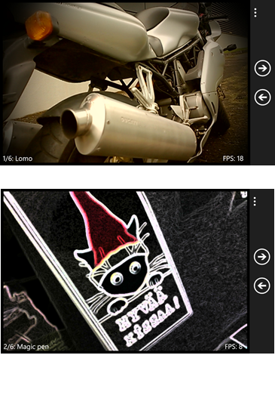
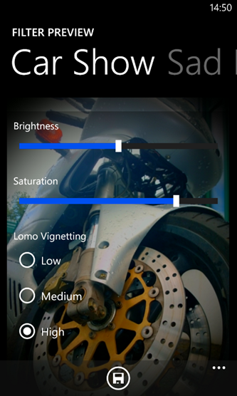
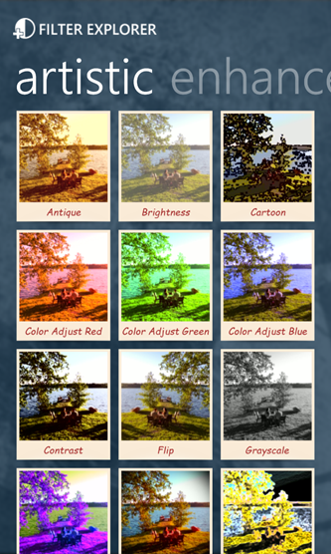
Example projects
Filter Effects, simple illustration of basics
Real-time Filter Demo, live viewfinder stream processing
Filter Explorer, complex illustration of various usage scenarios

Slide 29
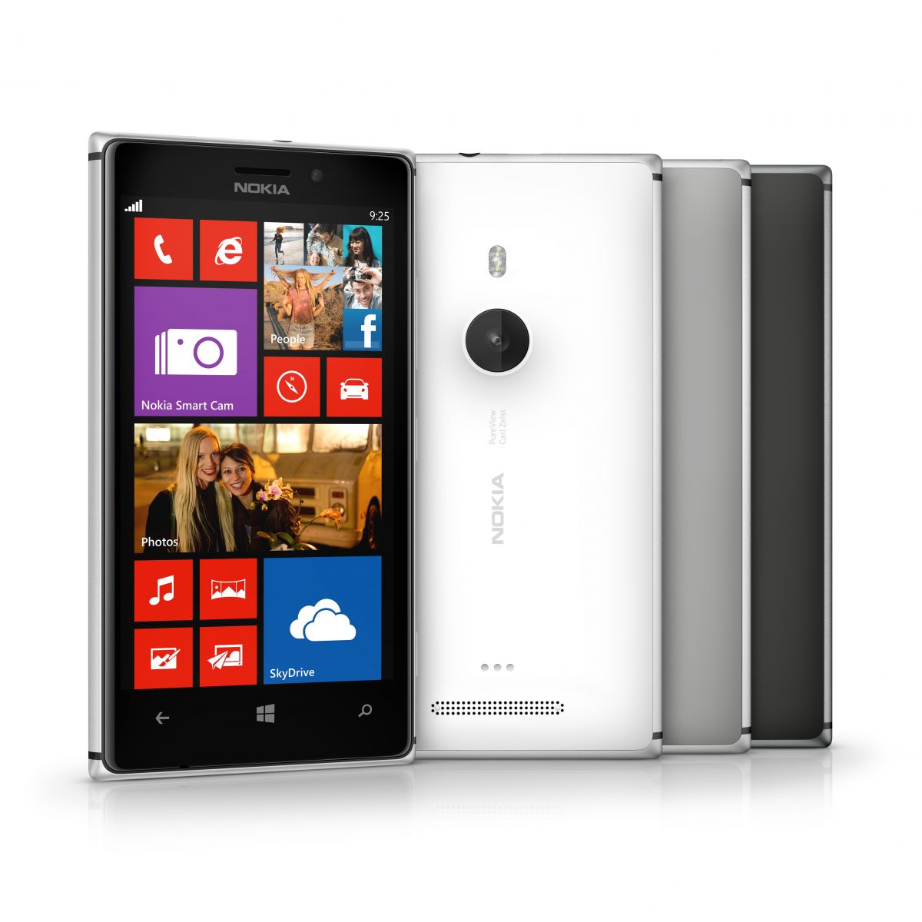
Good to know
Apps developed with the SDK can be used on any Windows Phone 8, including non-Nokia, devices
The library is a WinPRT library. Routines are available via a C# interface as well as a C/C++ interface
Nokia Imaging SDK License Agreement: Free to use, attribution

Slide 30
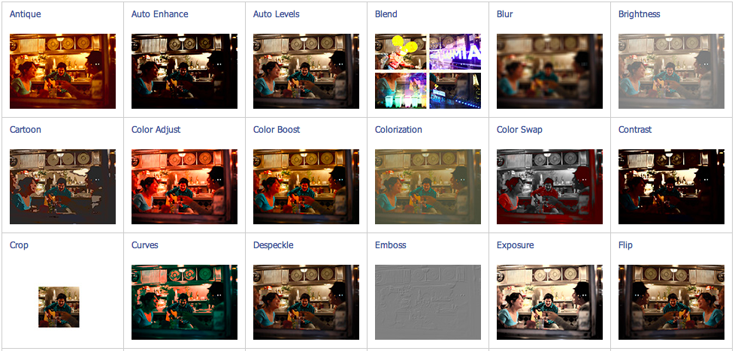
List of filters and effects I

Slide 31
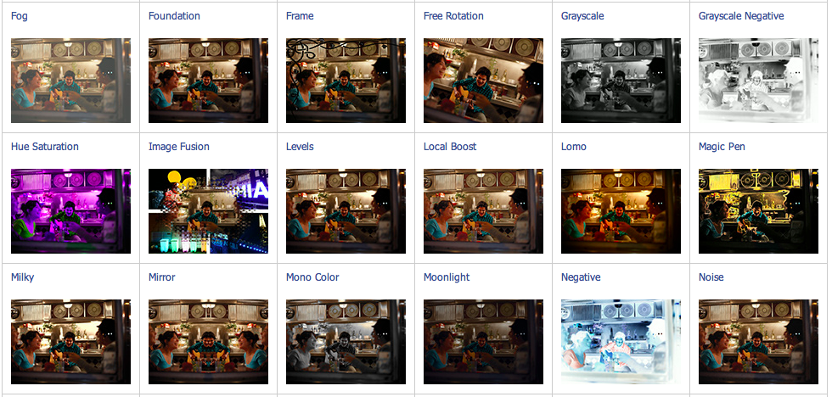
List of filters and effects II

Slide 32
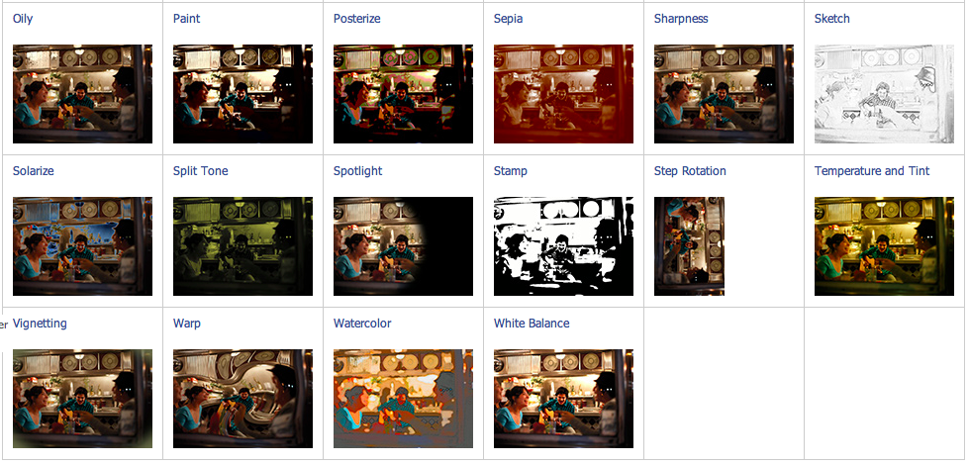
List of filters and effects III

Slide 33
General overview of required steps
Step 1: Include Nokia Imaging SDK Libraries into your project
Step 2 : Create EditingSession
Step 3 : Create and add filters to EditingSession
Step 4 : Use asynchronous methods RenderToImageAsync or RenderToJpegAsync to produce the final processed image

Slide 34
Step 1: Nokia Imaging SDK Libraries
Use NuGet to install the SDK libraries.
Finalise the installation by :
Making sure that in the Project’s Configuration Manager, only the X86 and ARM platforms are listed. The Any CPU platform should be removed
Save your project in Visual Studio
With an external editor (notepad, for example), edit the .csproj file to support both X86 and ARM platforms. In the <HintPath> elements, replace “X86” by “$(Platform)”.

Slide 35
Processor architectureS
Target | Processor architecture type
Emulator | X86
Phone | ARM
You don’t need to know/understand this to use the SDK!
Consider this as FYI.
 | Language | Compiled to | Runs in a virtual machine ? | Processor architecture dependant?
Managed code | C#, VB | Intermediate Language (MSIL) | Yes (CLR) | No
Native code | C++ | Machine language | No | Yes

Slide 36
Step 2: Create EditingSession
Create an Imaging SDK EditingSession using a compressed or uncompressed image:
From a Stream (from PhotoChooserTask):
EditingSession session = await CreateEditingSessionAsync(stream);
From a JPEG in a IBuffer:
EditingSession session = new EditingSession(jpegData);
From a WriteableBitmap:
EditingSession session = new EditingSession(sourceBitmap);

Slide 37
Step 3: Create and add filters and effects
Use FilterFactory to create filters and effects
Use EditingSession methods to add filters and effects:
session.AddFilter(FilterFactory.CreateCartoonFilter(true));
session.AddFilter(FilterFactory.CreateFogFilter());
You can also use FilterGroup to add several filters and effects in one call

Slide 38
Step 4: Produce final processed image
You can render the processed image to:
A XAML Image control:
await session.RenderToImageAsync(FilteredImage);
A WriteableBitmap :
await session.RenderToWriteableBitmapAsync(FilteredBitmap);
An IBuffer :
IBuffer jpegOut = await session.RenderToJpegAsync();

Slide 39
Resources
You found an error in the SDK, have suggestions, need help?
Nokia Imaging discussion board: http://nokia.ly/DiBoImg
You have developed an app with the SDK?
We’d love to hear about it. Tell us by sending a mail at developer-relations.marketing@nokia.com
Documentation and code samples
Imaging in the Lumia Developer’s Library: http://nokia.ly/WP_lib_img
Nokia Imaging SDK: http://www.developer.nokia.com/imaging

Slide 40
Windows phone resources
https://dev.windowsphone.com/
http://stackoverflow.com/questions/tagged/windows-phone
http://austin.devnokia.com

Slide 41
Win a lumia 925!
Write an app, get it published in the store by November 17, and contact me to be entered.
Only open to students here tonight!

Slide 42
THANK YOU!
Greg Stoll
ext-greg.stoll@nokia.com
@gregstoll
austin.devnokia.com
© 2012 Nokia. All rights reserved.

